Slide 1
Anonimous Types Anonymous Methods Extention Methods

Slide 2
Anonymous Type

Slide 3
Anonymous Type
In C#, an anonymous type is a type (class) without any name that can contain public read-only properties only. It cannot contain other members, such as fields, methods, events, etc.
You create an anonymous type using the new operator with an object initializer syntax. The implicitly typed variable- var is used to hold the reference of anonymous types.
The following example demonstrates creating an anonymous type student with three properties named Id, FirstName, and LastName.

Slide 4
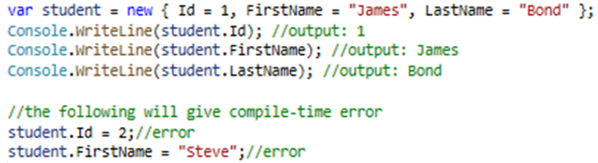
Anonymous Type
The properties of anonymous types are read-only and cannot be initialized with a null, anonymous function, or a pointer type. The properties can be accessed using dot (.) notation, same as object properties. However, you cannot change the values of properties as they are read-only.

Slide 5
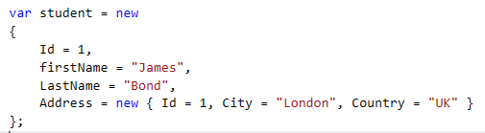
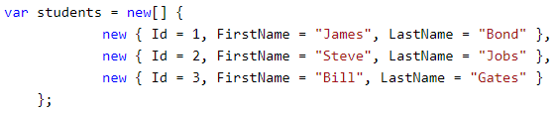
Anonymous Type
An anonymous type's property can include another anonymous type.
You can create an array of anonymous types also.

Slide 6
Anonymous Type
An anonymous type will always be local to the method where it is defined. It cannot be returned from the method.
However, an anonymous type can be passed to the method as object type parameter, but it is not recommended.
If you need to pass it to another method, then use struct or class instead of an anonymous type.

Slide 7
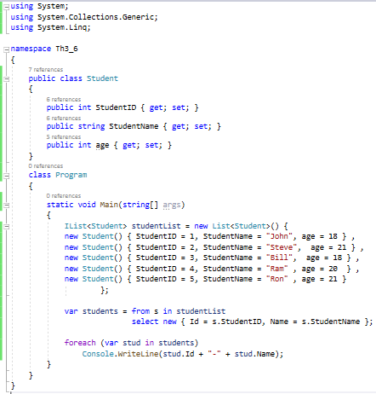

Anonymous Type
Mostly, anonymous types are created using the Select clause of a LINQ queries to return a subset of the properties from each object in the collection.
In the example, a select clause in the LINQ query selects only StudentID and StudentName properties and renames it to Id and Name, respectively. Thus, it is useful in saving memory and unnecessary code. The query result collection includes only StudentID and StudentName properties, as shown in the following debug view.

Slide 8
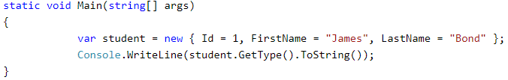
Anonymous Type
Internally, all the anonymous types are directly derived from the Object class. The compiler generates a class with some auto-generated name and applies the appropriate type to each property based on the value expression. Although your code cannot access it.
Use GetType() method to see the name.

Slide 9
Anonymous Type. Summary
Anonymous type is created using the new keyword and object initializer syntax.
The implicitly typed variable - var, is used to hold the reference of an anonymous type.
Anonymous type is a reference type data type and all the properties are read-only. It cannot contain methods, events, indexer or any other members.
A field, property, event, indexer, or return type of a method cannot be anonymous types.
The scope of an anonymous type is local to the method where it is defined. Mostly used in LINQ queries for temporary use.

Slide 10
Anonymous Method

Slide 11
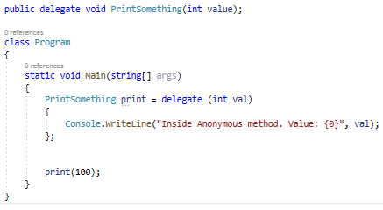
Anonymous Method
As the name suggests, an anonymous method is a method without a name.
Anonymous methods in C# can be defined using the delegate keyword and can be assigned to a variable of delegate type.

Slide 12
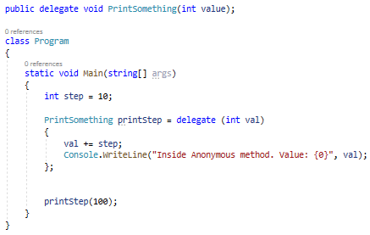
Anonymous Method
Anonymous methods can access variables defined in an outer function.

Slide 13
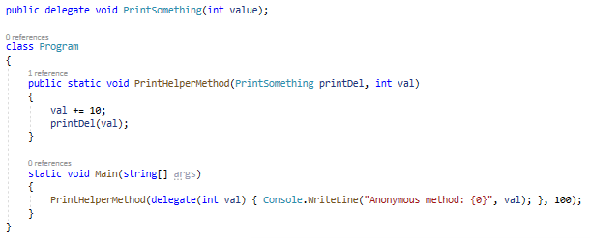
Anonymous Method
Anonymous methods can also be passed to a method that accepts the delegate as a parameter.
Notes:
In the following example, PrintHelperMethod() takes the first parameters of the Print delegate:

Slide 14
Anonymous Method. Summary
Anonymous method can be defined using the delegate keyword
Anonymous method must be assigned to a delegate.
Anonymous method can access outer variables or functions.
Anonymous method can be passed as a parameter.
Anonymous method can be used as event handlers.
Anonymous Method Limitations
It cannot contain jump statement like goto, break or continue.
It cannot access ref or out parameter of an outer method.
It cannot have or access unsafe code.
It cannot be used on the left side of the is operator.

Slide 15
Lambda Expression

Slide 16
Anatomy of the Lambda Expression
The lambda expression is a shorter way of representing anonymous method using some special syntax.
For example, following anonymous method checks if student is teenager or not:
The above anonymous method can be represented using a Lambda Expression in C# as below:

Slide 17
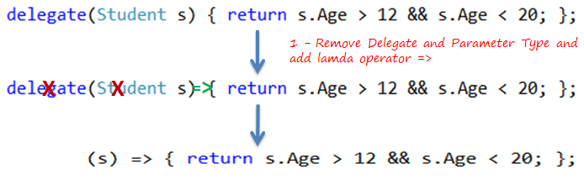
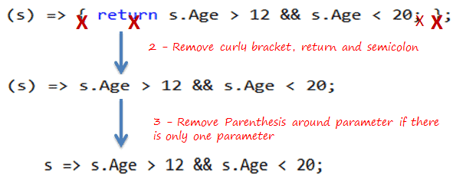
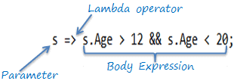
Anatomy of the Lambda Expression
The Lambda expression evolves from anonymous method by first removing the delegate keyword and parameter type and adding a lambda operator =>.
The above lambda expression is absolutely valid, but we don't need the curly braces, return and semicolon if we have only one statement that returns a value. So we can eliminate it. Also, we can remove parenthesis (), if we have only one parameter.

Slide 18
Lambda Expression with Multiple Parameters
You can wrap the parameters in parenthesis if you need to pass more than one parameter, as below:
You can also give type of each parameters if parameters are confusing:

Slide 19
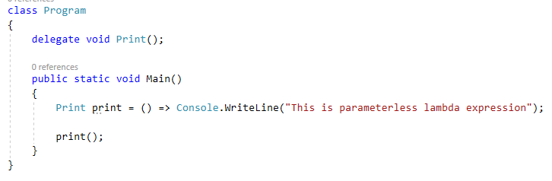
Lambda Expression without Parameter
It is not necessary to have at least one parameter in a lambda expression. The lambda expression can be specify without any parameter also.

Slide 20
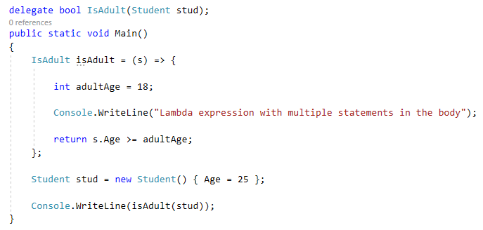
Declare Local Variable in Lambda Expression Body
You can declare a variable in the expression body to use it anywhere in the expression body.

Slide 21
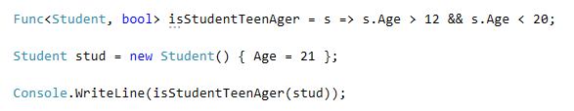
Assign Lambda Expression to Delegate
The lambda expression can be assigned to Func<in T, out TResult> type delegate. The last parameter type in a Func delegate is the return type and rest are input parameters.
Consider the following lambda expression to find out whether a student is a teenager or not.

Slide 22
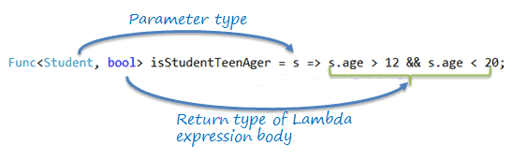
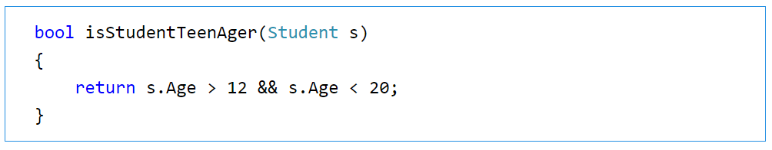
Assign Lambda Expression to Delegate
In the example, the Func delegate expects the first input parameter to be of Student type and the return type to be boolean. The lambda expression s => s.age > 12 && s.age < 20 satisfies the Func<Student, bool> delegate requirement, as shown below:
The Func<> delegate shown above, would turn out to be a function as shown below.

Slide 23
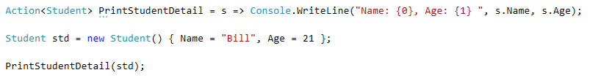
Action Delegate
Unlike the Func delegate, an Action delegate can only have input parameters. Use the Action delegate type when you don't need to return any value from lambda expression.

Slide 24
Lambda Expression. Summary
Lambda Expression is a shorter way of representing anonymous method.
Lambda Expression syntax: parameters => body expression
Lambda Expression can have zero parameter.
Lambda Expression can have multiple parameters in parenthesis ().
Lambda Expression can have multiple statements in body expression in curly brackets {}.
Lambda Expression can be assigned to Func, Action or Predicate delegate.
Lambda Expression can be invoked in a similar way to delegate.

Slide 25
Extension Method

Slide 26

Extension Method
Extension methods, as the name suggests, are additional methods. Extension methods allow you to inject additional methods without modifying, deriving or recompiling the original class, struct or interface. Extension methods can be added to your own custom class, .NET framework classes, or third party classes or interfaces.
In the following example, IsGreaterThan() is an extension method for int type, which returns true if the value of the int variable is greater than the supplied integer parameter.
The IsGreaterThan() method is not a method of int data type (Int32 struct). It is an extension method written by the programmer for the int data type. The IsGreaterThan() extension method will be available throughout the application by including the namespace in which it has been defined.

Slide 27
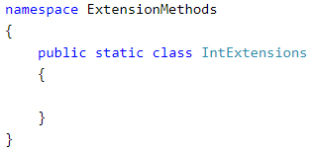
Extension Method
An extension method is actually a special kind of static method defined in a static class. To define an extension method, first of all, define a static class.
For example, we have created an IntExtensions class under the ExtensionMethods namespace in the following example. The IntExtensions class will contain all the extension methods applicable to int data type. (You may use any name for namespace and class.)
1. Create a Class for Extension Methods

Slide 28
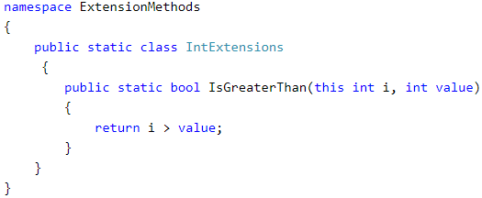
Extension Method
Now, define a static method as an extension method where the first parameter of the extension method specifies the type on which the extension method is applicable. We are going to use this extension method on int type. So the first parameter must be int preceded with the this modifier.
For example, the IsGreaterThan() method operates on int, so the first parameter would be, this int i.
2. Define an Extension Method

Slide 29
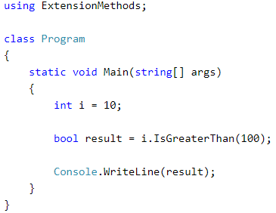
Extension Method
Now, you can include the ExtensionMethods namespace wherever you want to use this extension method.
3. Extension method
The only difference between a regular static method and an extension method is that the first parameter of the extension method specifies the type that it is going to operator on, preceeded by the this keyword.

Slide 30
Extension Method. Summary
Extension methods are additional custom methods which were originally not included with the class.
Extension methods can be added to custom, .NET Framework or third party classes, structs or interfaces.
The first parameter of the extension method must be of the type for which the extension method is applicable, preceded by the this keyword.
Extension methods can be used anywhere in the application by including the namespace of the extension method.

Slide 31
Thank You

